Slide 1
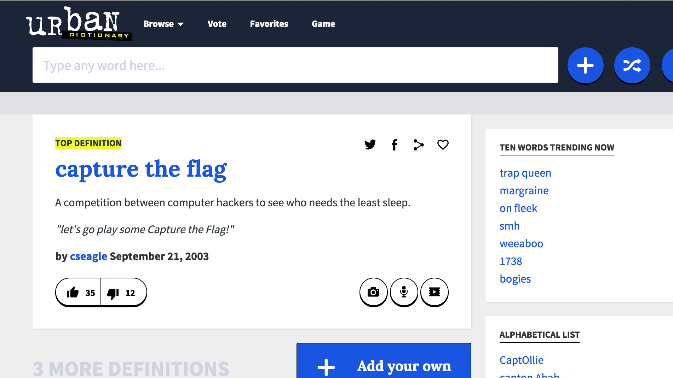
CYBER GRAND CHALLENGE
Ryan Stortz
Trail of Bits
12 August 2015
Notes:
I was asked to present about Trail of Bit’s CRS and the Cyber Grand Challenge in general.
To start we need to cover a little background, starting with capture the flag.

Slide 2
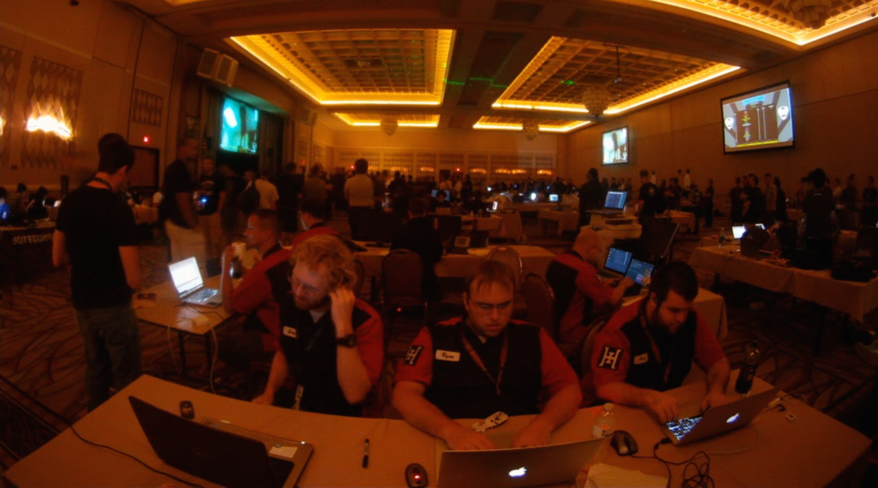
Capture the FLAG
Notes:
Who’s heard of capture the flag?

Slide 3
Capture the Flag
Capture the Flag is a competition that tests a variety of computer security-related skills.
Challenge areas include:
Cryptanalysis
Forensics
Network Analysis
Network and Application Exploitation
Programming
Reverse Engineering
Trivia
Notes:
So, Capture the Flag is a computer security competition that has exploded in popularity in the last 5 years, with hundreds of competitions now. Challenges cover most areas of computer security and generally, computer science.

Slide 4
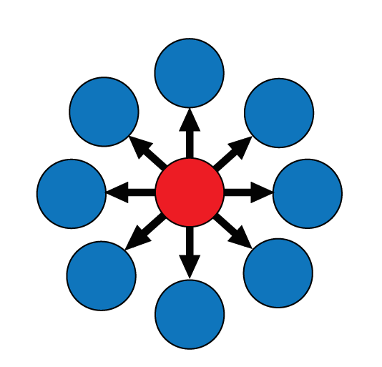
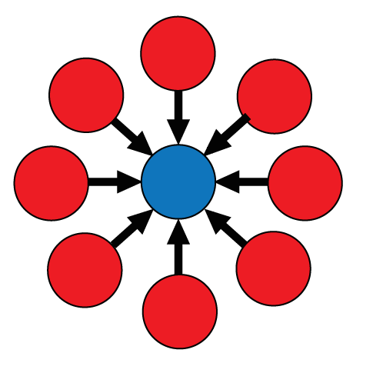
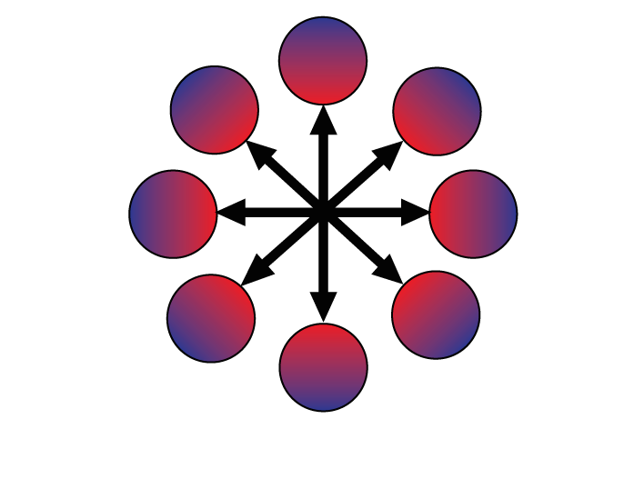
CTF Competition Format
Blue Team
Red Team
Full Spectrum
Notes:
Competitions fit one of these three models

Slide 5
Blue Team
Focused on IT Security
Collegiate Cyber Defense Competition (CCDC)
CyberPatriot
Largely IT security competitions
Sometimes described as “Patch and Pray”
Embraces the term “Cyber”
Notes:
First, the blue team model. Where there’s a central red or white team that attacks individual “blue team” competitors. These competitions largely focus on IT security preparedness and response.
Cyber cyber defense cyber
No counter attack
No attribution attempts

Slide 6
Red Team
Scoreboard-driven competitions
Ghost in the Shellcode
PlaidCTF
CSAW CTF
By far the most popular
International scores are tracked @ www.ctftime.org
Notes:
The second model is the Red team competition. Most popular CTFs are this model. They’re normally scoreboard driven with a central blue team organizer that is attacked by all the competing teams for points.

Slide 7
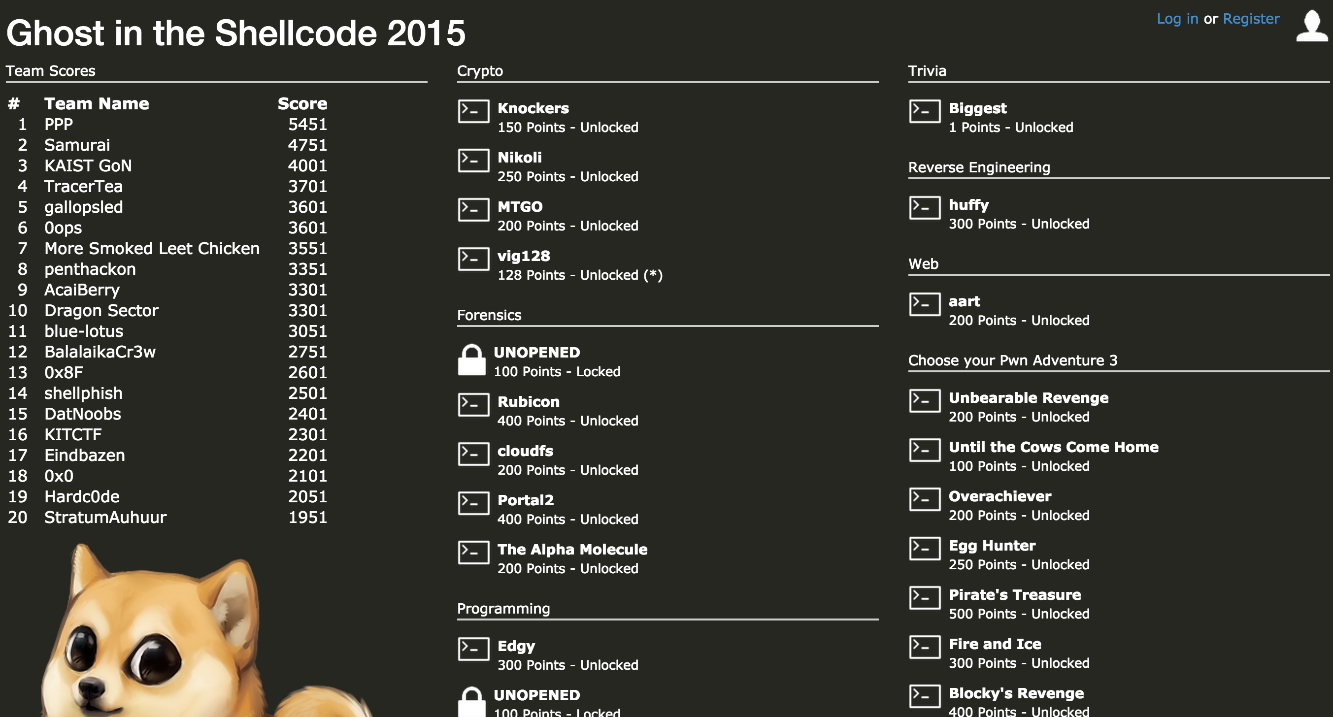
Notes:
Here’s an example red team ctf scoreboard.

Slide 8
Full Spectrum
Attack-Defense
DEFCON CTF
RuCTFe
Most dynamic of the three formats
Basically unrestricted cyber war in a single room
Teams host and patch custom vulnerable services, while attacking the same services run by other teams.
Notes:
The final model is “full spectrum” where both attack and defense are required. These are more rare, but they’re the most dynamic. Attack/Defense CTFs require the largest diversity of skills and tools.
No limits
This is the model we’re concerned with…

Slide 9


Why does this matter?
Many people believe CTF is the best crucible for tool & strategy development
Specifically Full Spectrum competitions
HatesIrony made custom tools for:
Reverse Engineering
Packet Analysis
Automated Network Exploitation
Key/Flag Submission
Runtime Application Defenses
Network De-anonymizationTools
...and we threw them out each year as the game evolved
https://binary.ninja/
Notes:
Why does this matter? Well, some people believe that CTF causes a pure form of innovation. When I was on HatesIrony, we would show up to DEFCON CTF with custom solutions for RE, exploitation, network analysis…and we’d develop new tools as needed during the game.
This leads us to the cyber grand challenge

Slide 10
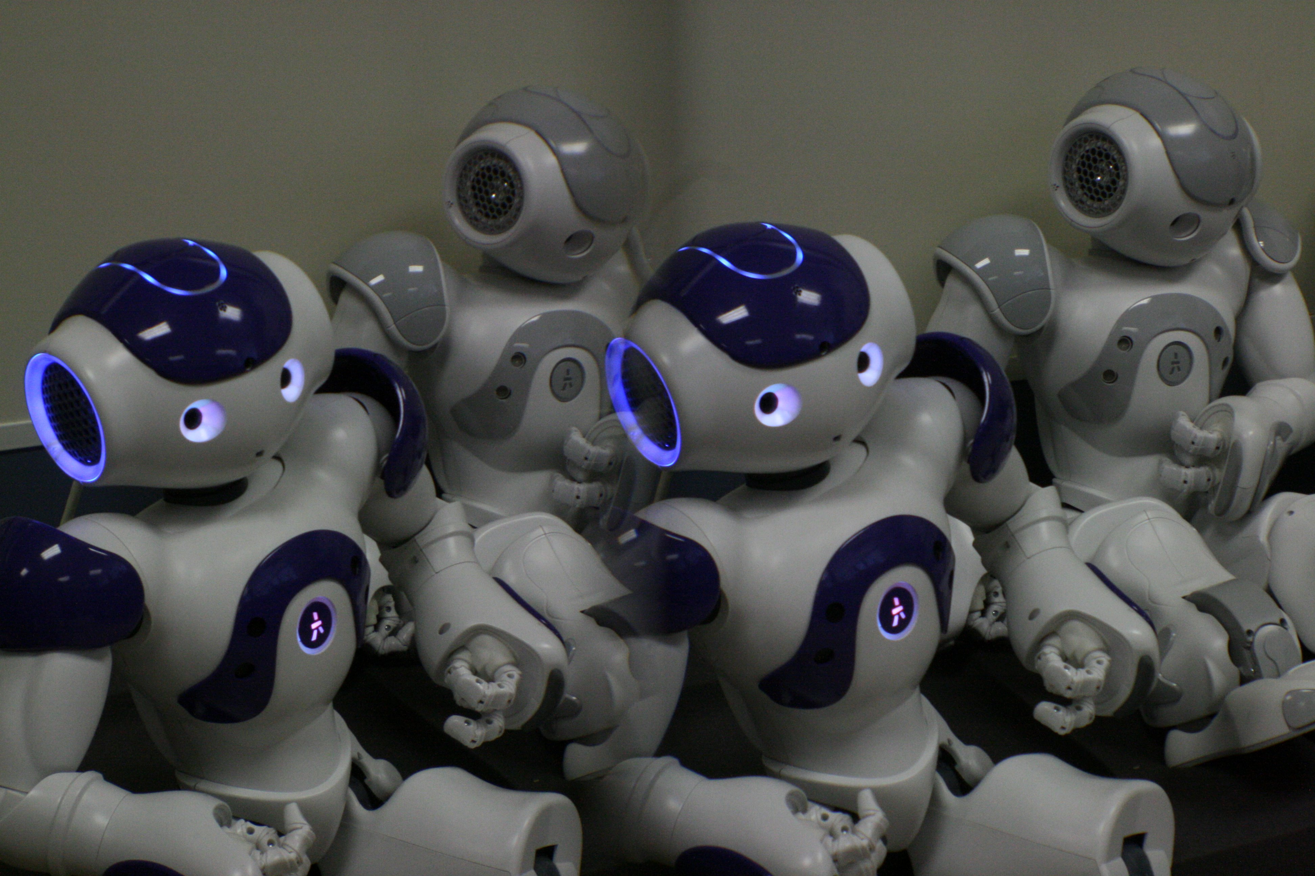
The CYBER GRAND CHALLENGE
Notes:
The Cyber Grand Challenge is what you get when you tell people with money about CTF.

Slide 11
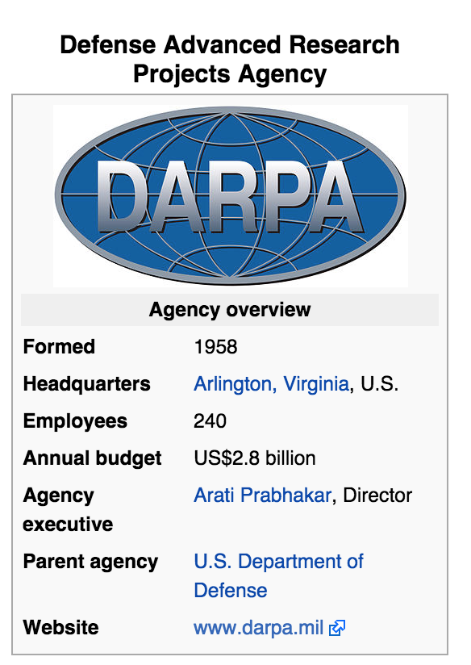
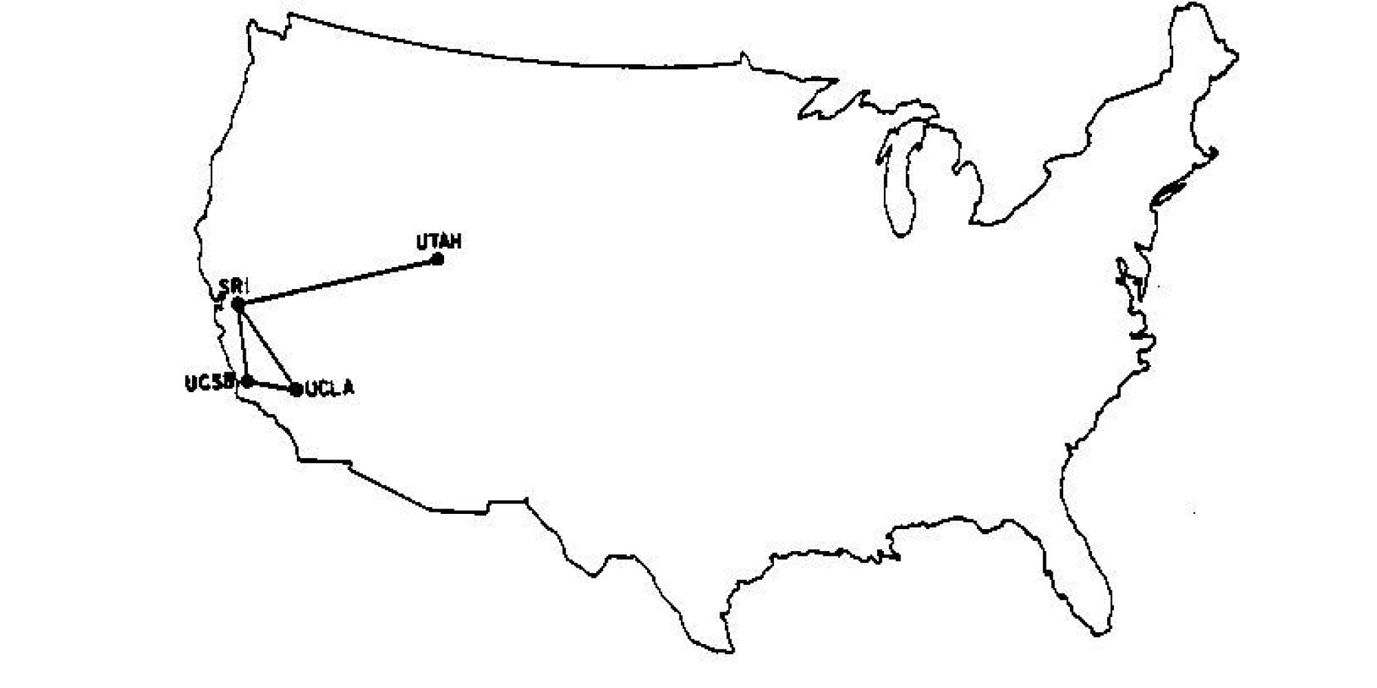
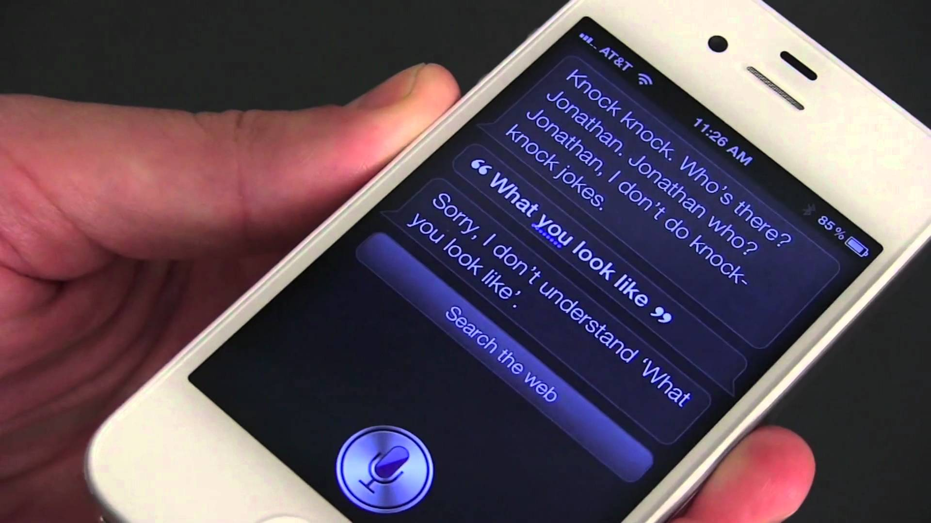
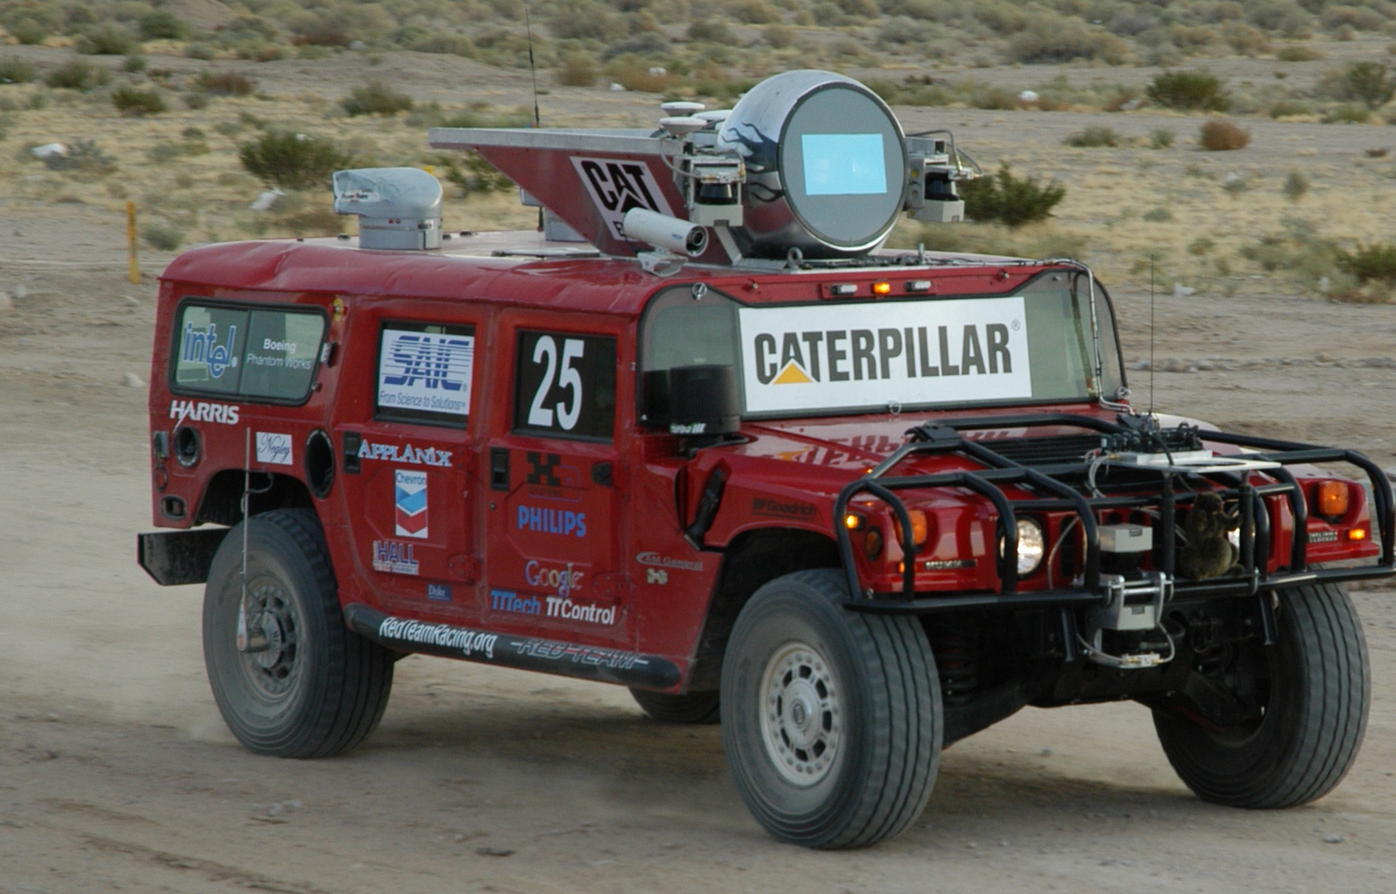
ARPANET
1969
Siri
2003
Grand Challenge
2004
Notes:
DARPA (at the surface) is a magical organization that exists purely to make things happen. Including the Internet, Siri, and autonomous vehicles.
~$12M a year per employee

Slide 12

CTF Nerds + DARPA

Slide 13

Cyber Grand Challenge
“Cyber Grand Challenge (CGC) is a contest to build high-performance computers capable of playing in a Capture-the-Flag style cyber-security competition.”
Notes:
The Cyber Grand Challenge is a competition to pit computers against each other in a CTF.
But why?

Slide 14
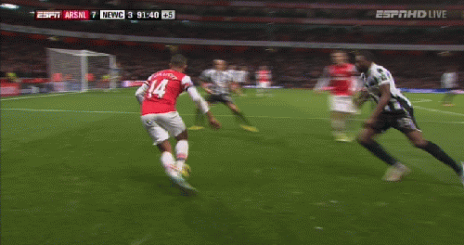
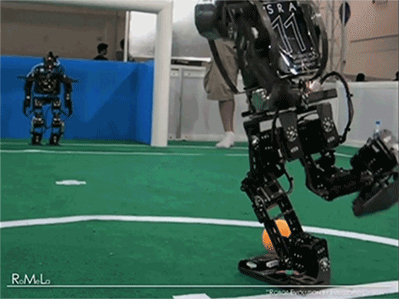
Humans > Robots
* Yes, even at software
Notes:
Well, it’s because in terms of CTF, humans are still much better than robots. So DARPA created a robot-only competition where these systems can compete against each other in a feedback loop. This animation on the right is actually from a similar competition to make soccer playing robots.

Slide 15
Competition Setup
Teams build “Cyber Reasoning Systems”
Fully autonomous systems
Given a bundle of Challenge Binaries (CBs)
CB := “Pwnables”
Teams create Proof of Vulnerabilities (PoV)
PoVs are inputs that trigger vulnerable code paths (via a crash)
CRSs will compete against each other
Notes:
So, the competition is set up where a dozen or so teams build Cyber Reasoning Systems. These systems will be expected to automatically process custom created executables, identify software vulnerabilities in them, and develop proof of vulnerabilties – which are inputs that tickle the vulnerable code path to prove its existence and reachability.
These CRSs will eventually compete head to head against each other.

Slide 16
DECREE
OS: DECREE
DARPA Experimental Cyber Research Evaluation Environment
Similar to Linux x86
Executables are statically-linked ELFs
Implemented as a new binfmt
Removes complexity
Very clever implementation
# | Syscall | Linux Eq.
1 | _terminate | exit
2 | transmit | send
3 | receive | recv
4 | fdwait | select
5 | allocate | mmap
6 | deallocate | munmap
7 | random | n/a
Notes:
To facilitate the competition and reduce the complexity, DARPA developed DECREE. A custom ABI with only 7 system calls. You can’t open files, you can’t open sockets, you can’t fork. You can’t really write real software on it but it’s a great starting point for the competition.
The syscalls are listed here.

Slide 17
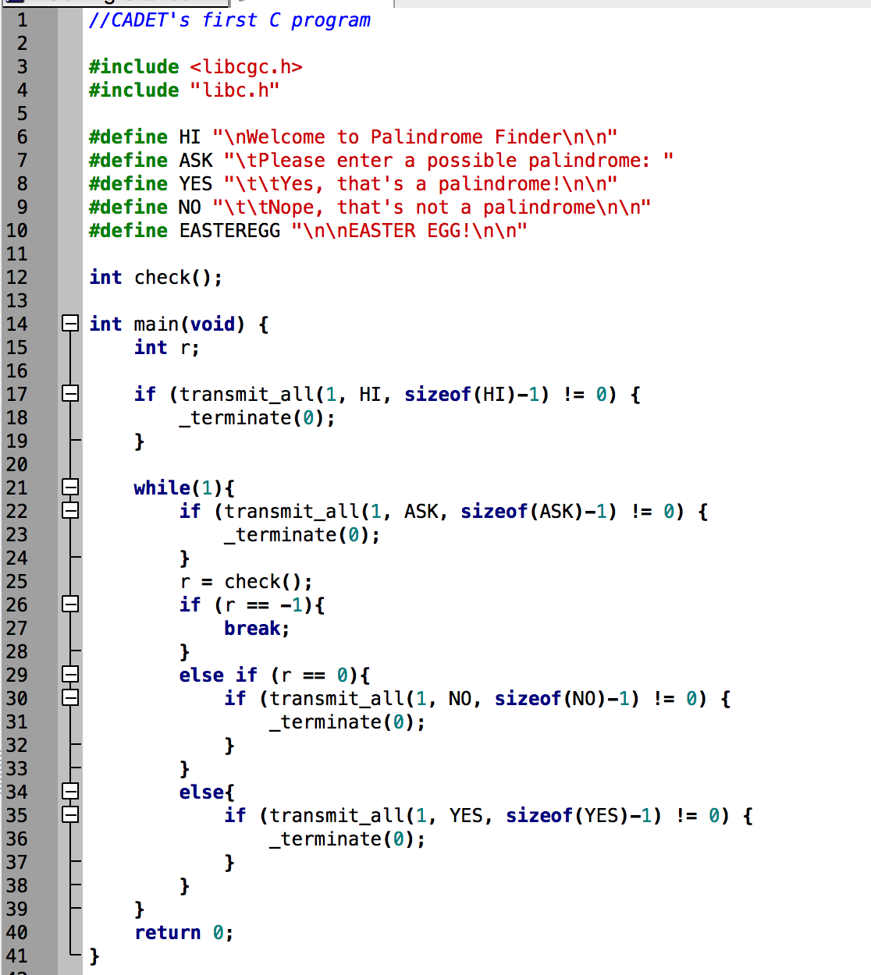
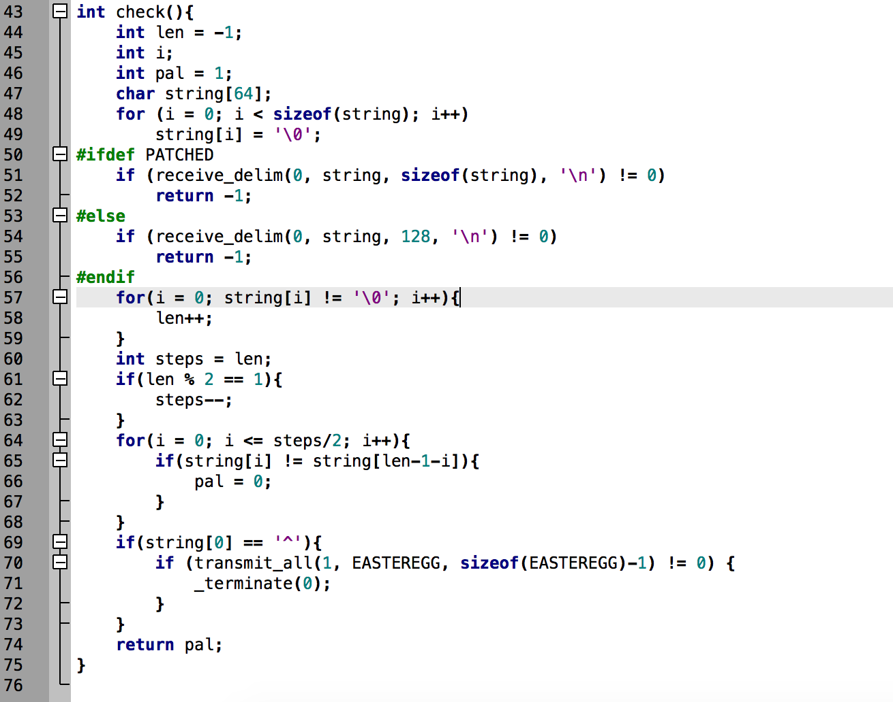
Example Challenge
Example Challenge: CADET_0001
Notes:
Here’s an example challenge. We’d actually be given this as a compiled executable, but it’s easier to visualize with the source code. This implements a network service that tells you if a string is a palindrome or not.
Can you spot the bug?
It reads too much data into a fixed size stack buffer, resulting in a stack smash.

Slide 18

Our Cyber Reasoning System
Notes:
So, now that we’ve covered the background, we can talk about trail of bits’ crs.
It’s full of skynet references. From what we can tell, DARPA doesn’t appreciate them, but we find it hilarious.

Slide 19
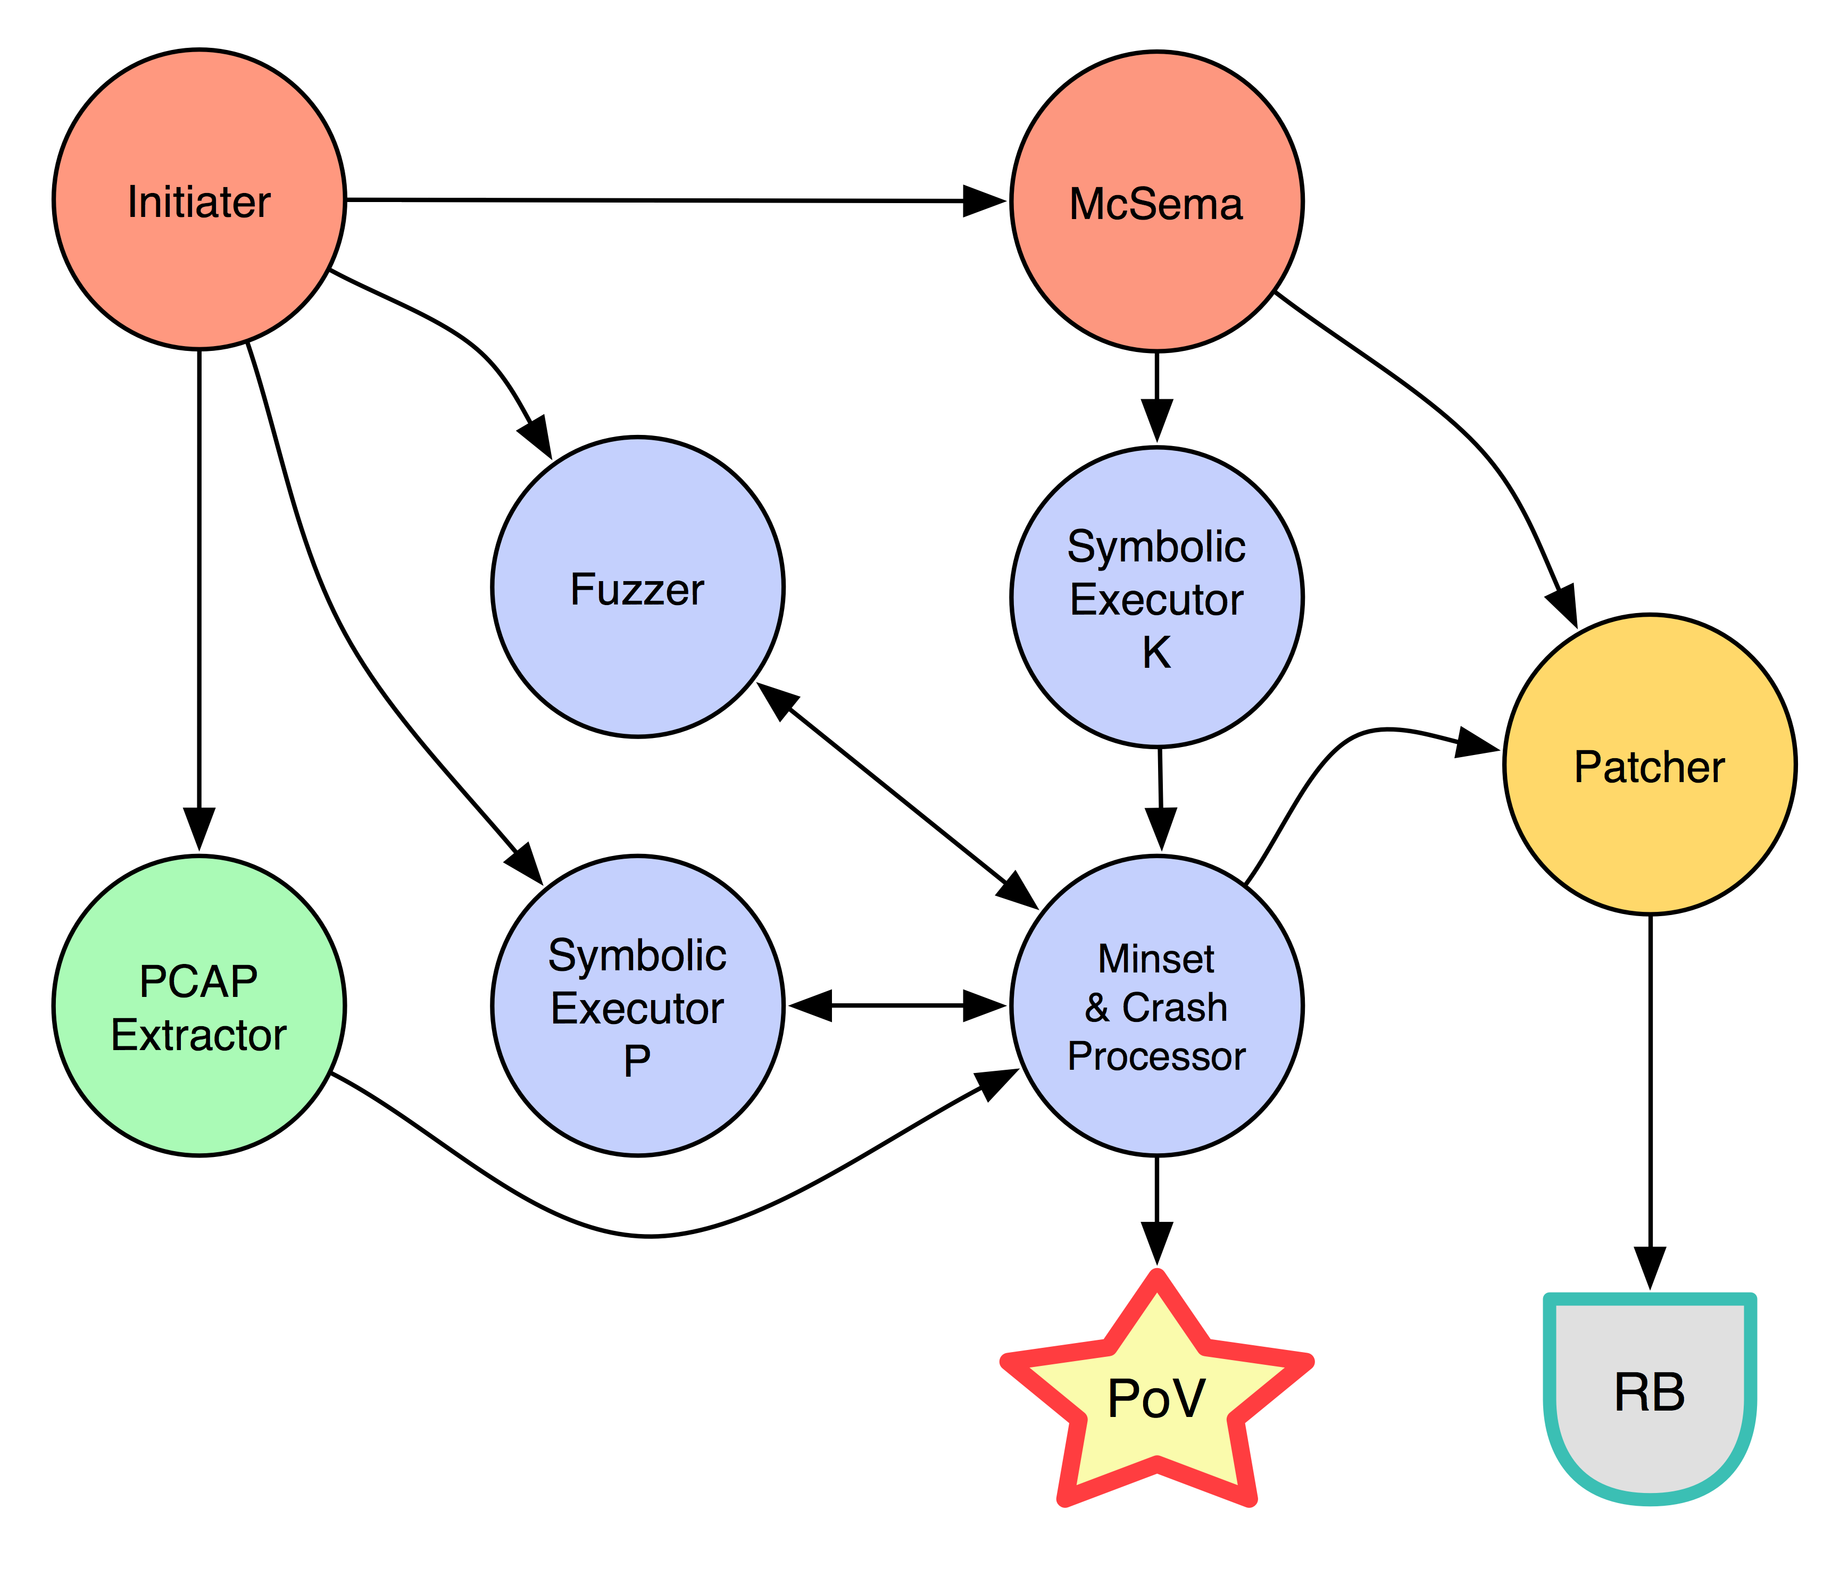
Notes:
Here’s a rough diagram of the components. The initiator takes in the challenge binaries and sample network captures. Sends the binaries to mcsema, the fuzzer, and one of our symbolic execution engines. The pcaps go to the extractor which turns them into testcases….

Slide 20


Slide 21
Bug Finding
Fuzzing
Symbolic Execution
Concolic Execution
Concrete + Symbolic….get it? Ha ha…
Notes:
For bug finding, we used 3 techniques. Fuzzing, symbex, and concolic execution – which is the combination of the first two.

Slide 22
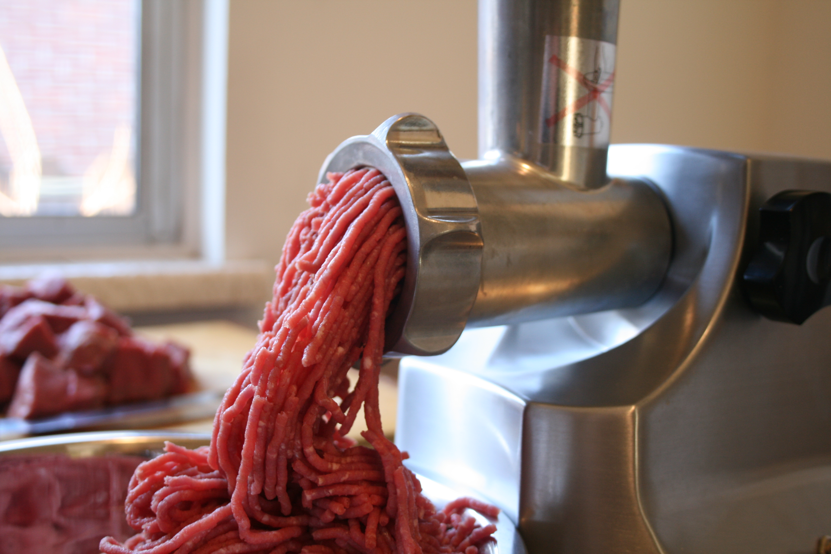
Fuzzing
Notes:
Let’s cover fuzzing.

Slide 23
Fuzzing
Fuzzing is a technique where you take valid inputs, corrupt them slightly, feed them through an application, and hope for a crash.
Extremely effective for many file formats
Requires good input data to be truly effective
Notes:
Fuzzing is high payout, low cost technique to identify software vulnerabilities. I hope this isn’t new information to anyone.

Slide 24

Granary - Binary Translation
Persistent Code Cache
Code Coverage
No System IO
Granary emulated all of it
One instance = 400,000 test cases/hour
We had ~10,000 instances for the qualifier
Notes:
We used a custom DBT called Granary to enable our fuzzing and optimize it. It used a persistent code cache that allowed us to instrument the binary once and run forever. It handled all DECREE system calls itself, removing system IO. We could get 400,000 test cases an hour per instance.

Slide 25
Minset
Collects the “Minimum Set” of inputs to cause the maximum amount of path coverage.
Notes:
To optimize test case selection – which is the one we choose to fuzz – we had a minset service. This service just helped us better represent the paths available. For example, blue may be just error conditions that quickly bail. It’s easy to get hundreds or thousands of examples for these paths, but they’re not really interesting. We want to equally fuzz every path we have. Favoring one area might mean it’s not very deep.

Slide 26
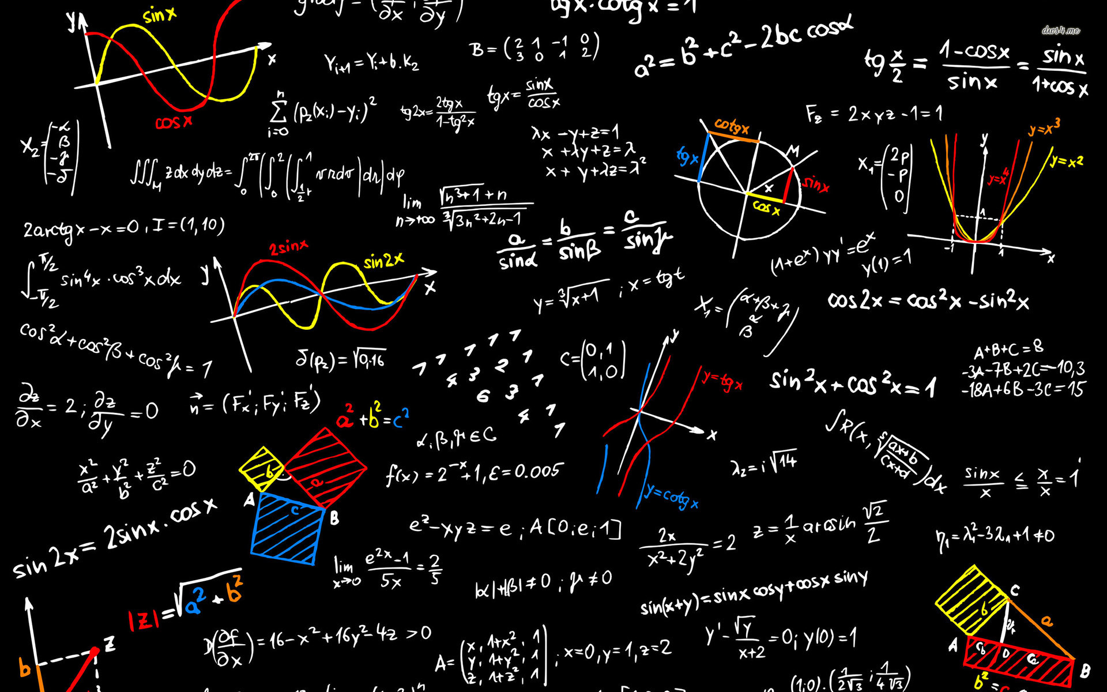
Symbolic Execution
Notes:
The next technique we used was symbolic execution. We had two symbolic execution engines.
Symbolic execution can be a little scary, but it’s pretty straight-forward. Implementing one is a engineering problem.
If concrete executions -- normal executions – are arithmetic, then symbolic execution is algebra.

Slide 27
Concrete Execution : Symbolic Execution :: Arithmetic : Algebra
1 int ex(int a, int b)
2 {
3 int x = 0, y = 0;
4
5 if (a == 2) {
6 x = 2;
7 }
8
9 if (b > 10) {
10 y = 1;
11 } else {
12 y = b;
13 }
14
15 return x + y;
16 }
A | B | X
5 | 12 | -
Y | RV
- | -
Notes:
I have an example of each here that we can walk through.

Slide 28
Concrete Execution : Symbolic Execution :: Arithmetic : Algebra
1 int ex(int a, int b)
2 {
3 int x = 0, y = 0;
4
5 if (a == 2) {
6 x = 2;
7 }
8
9 if (b > 10) {
10 y = 1;
11 } else {
12 y = b;
13 }
14
15 return x + y;
16 }
A | B | X
5 | 12 | 0
Y | RV
0 | -

Slide 29
Concrete Execution : Symbolic Execution :: Arithmetic : Algebra
1 int ex(int a, int b)
2 {
3 int x = 0, y = 0;
4
5 if (a == 2) {
6 x = 2;
7 }
8
9 if (b > 10) {
10 y = 1;
11 } else {
12 y = b;
13 }
14
15 return x + y;
16 }
A | B | X
5 | 12 | 0
Y | RV
0 | -

Slide 30
Concrete Execution : Symbolic Execution :: Arithmetic : Algebra
1 int ex(int a, int b)
2 {
3 int x = 0, y = 0;
4
5 if (a == 2) {
6 x = 2;
7 }
8
9 if (b > 10) {
10 y = 1;
11 } else {
12 y = b;
13 }
14
15 return x + y;
16 }
A | B | X
5 | 12 | 0
Y | RV
0 | -

Slide 31
Concrete Execution : Symbolic Execution :: Arithmetic : Algebra
1 int ex(int a, int b)
2 {
3 int x = 0, y = 0;
4
5 if (a == 2) {
6 x = 2;
7 }
8
9 if (b > 10) {
10 y = 1;
11 } else {
12 y = b;
13 }
14
15 return x + y;
16 }
A | B | X
5 | 12 | 0
Y | RV
1 | -

Slide 32
Concrete Execution : Symbolic Execution :: Arithmetic : Algebra
1 int ex(int a, int b)
2 {
3 int x = 0, y = 0;
4
5 if (a == 2) {
6 x = 2;
7 }
8
9 if (b > 10) {
10 y = 1;
11 } else {
12 y = b;
13 }
14
15 return x + y;
16 }
A | B | X
5 | 12 | 0
Y | RV
1 | 1

Slide 33
Concrete Execution : Symbolic Execution :: Arithmetic : Algebra
1 int ex(int a, int b)
2 {
3 int x = 0, y = 0;
4
5 if (a == 2) {
6 x = 2;
7 }
8
9 if (b > 10) {
10 y = 1;
11 } else {
12 y = b;
13 }
14
15 return x + y;
16 }
A | B | X
? | ? | -
Y | RV
- | -
Notes:
Now let’s walk through the symbolic one. We start with A and B being symbolic, meaning they represent any value.

Slide 34
Concrete Execution : Symbolic Execution :: Arithmetic : Algebra
1 int ex(int a, int b)
2 {
3 int x = 0, y = 0;
4
5 if (a == 2) {
6 x = 2;
7 }
8
9 if (b > 10) {
10 y = 1;
11 } else {
12 y = b;
13 }
14
15 return x + y;
16 }
A | B | X
? | ? | 0
Y | RV
0 | -

Slide 35
Concrete Execution : Symbolic Execution :: Arithmetic : Algebra
1 int ex(int a, int b)
2 {
3 int x = 0, y = 0;
4
5 if (a == 2) {
6 x = 2;
7 }
8
9 if (b > 10) {
10 y = 1;
11 } else {
12 y = b;
13 }
14
15 return x + y;
16 }
A | B | X
? | ? | 0
Y | RV
0 | -
Notes:
At line 5, we hit our first branch. It tests if A is 2. We don’t know what A is, so we have to go down it.

Slide 36
Concrete Execution : Symbolic Execution :: Arithmetic : Algebra
1 int ex(int a, int b)
2 {
3 int x = 0, y = 0;
4
5 if (a == 2) {
6 x = 2;
7 }
8
9 if (b > 10) {
10 y = 1;
11 } else {
12 y = b;
13 }
14
15 return x + y;
16 }
A | B | X
? | ? | 2∧(a==2)
Y | RV
0 | -
Notes:
So this is where it starts to be different. X can equal 2, but only if A also equals 2. So X is 2 anded with a==2. The path constraint is encoded into the value of X.

Slide 37
Concrete Execution : Symbolic Execution :: Arithmetic : Algebra
1 int ex(int a, int b)
2 {
3 int x = 0, y = 0;
4
5 if (a == 2) {
6 x = 2;
7 }
8
9 if (b > 10) {
10 y = 1;
11 } else {
12 y = b;
13 }
14
15 return x + y;
16 }
A | B | X
? | ? | 2∧(a==2)
Y | RV
0 | -

Slide 38
Concrete Execution : Symbolic Execution :: Arithmetic : Algebra
1 int ex(int a, int b)
2 {
3 int x = 0, y = 0;
4
5 if (a == 2) {
6 x = 2;
7 }
8
9 if (b > 10) {
10 y = 1;
11 } else {
12 y = b;
13 }
14
15 return x + y;
16 }
A | B | X
? | ? | 2∧(a==2)
Y | RV
1∧(b>10) | -
Notes:
Much like above, we have a path constraint on a symbolic variable, so we have to explore the branch.

Slide 39
Concrete Execution : Symbolic Execution :: Arithmetic : Algebra
1 int ex(int a, int b)
2 {
3 int x = 0, y = 0;
4
5 if (a == 2) {
6 x = 2;
7 }
8
9 if (b > 10) {
10 y = 1;
11 } else {
12 y = b;
13 }
14
15 return x + y;
16 }
A | B | X
? | ? | 2∧(a==2)
Y | RV
1∧(b>10)∨b∧(b≤10) | -
Notes:
But we also have to explore the else branch of this conditional. Now we have Y == 1 if B is greater than 10 OR Y == B if B is <= 10.

Slide 40
Concrete Execution : Symbolic Execution :: Arithmetic : Algebra
1 int ex(int a, int b)
2 {
3 int x = 0, y = 0;
4
5 if (a == 2) {
6 x = 2;
7 }
8
9 if (b > 10) {
10 y = 1;
11 } else {
12 y = b;
13 }
14
15 return x + y;
16 }
A | B | X
? | ? | 2∧(a==2)
Y | RV
1∧(b>10)∨b∧(b≤10) | 2∧(a==2) + 1∧(b>10)∨b∧(b≤10)
Notes:
Our return value is also symbolic.

Slide 41
Concrete Execution : Symbolic Execution :: Arithmetic : Algebra
1 int ex(int a, int b)
2 {
3 int x = 0, y = 0;
4
5 if (a == 2) {
6 x = 2;
7 }
8
9 if (b > 10) {
10 y = 1;
11 } else {
12 y = b;
13 }
14
15 return x + y;
16 }
a=2 b=?
# | A | B
1 | ==2 | >10
2 | ==2 | ≤10
3 | !=2 | >10
4 | !=2 | ≤10
a=? b>10
a=? b≤10
Notes:
Symbolic execution can be used for a lot of things. One example is test case generation.
We can actually identify every conditional path predicated on a symbolic value and figure out the constraints. This function has 4 distinct execution paths, and here are the inputs that touch each.

Slide 42
Input generation with SMT-LIB
(assert (= V (concat ((_ extract 7 7) (select RECEIVE #x00000003))
(bvnot ((_ extract 6 6) (select RECEIVE #x00000003)))
((_ extract 5 1) (select RECEIVE #x00000003))
(bvnot ((_ extract 0 0) (select RECEIVE #x00000003)))
((_ extract 7 7) (select RECEIVE #x00000002))
(bvnot ((_ extract 6 6) (select RECEIVE #x00000002)))
((_ extract 5 2) (select RECEIVE #x00000002))
(bvnot ((_ extract 1 1) (select RECEIVE #x00000002)))
((_ extract 0 0) (select RECEIVE #x00000002))
((_ extract 7 7) (select RECEIVE #x00000001))
(bvnot ((_ extract 6 6) (select RECEIVE #x00000001)))
((_ extract 5 2) (select RECEIVE #x00000001))
(bvnot ((_ extract 1 0) (select RECEIVE #x00000001)))
(assert (= V (concat ((_ extract 7 7) (select RECEIVE #x00000003))
(bvnot ((_ extract 6 6) (select RECEIVE #x00000003)))
((_ extract 5 1) (select RECEIVE #x00000003))
(bvnot ((_ extract 0 0) (select RECEIVE #x00000003)))
((_ extract 7 7) (select RECEIVE #x00000002))
(bvnot ((_ extract 6 6) (select RECEIVE #x00000002)))
((_ extract 5 2) (select RECEIVE #x00000002))
(bvnot ((_ extract 1 1) (select RECEIVE #x00000002)))
((_ extract 0 0) (select RECEIVE #x00000002))
((_ extract 7 7) (select RECEIVE #x00000001))
(bvnot ((_ extract 6 6) (select RECEIVE #x00000001)))
((_ extract 5 2) (select RECEIVE #x00000001))
(bvnot ((_ extract 1 0) (select RECEIVE #x00000001)))
(assert (= V (concat ((_ extract 7 7) (select RECEIVE #x00000003))
(bvnot ((_ extract 6 6) (select RECEIVE #x00000003)))
((_ extract 5 1) (select RECEIVE #x00000003))
(bvnot ((_ extract 0 0) (select RECEIVE #x00000003)))
((_ extract 7 7) (select RECEIVE #x00000002))
(bvnot ((_ extract 6 6) (select RECEIVE #x00000002)))
((_ extract 5 2) (select RECEIVE #x00000002))
(bvnot ((_ extract 1 1) (select RECEIVE #x00000002)))
((_ extract 0 0) (select RECEIVE #x00000002))
((_ extract 7 7) (select RECEIVE #x00000001))
(bvnot ((_ extract 6 6) (select RECEIVE #x00000001)))
((_ extract 5 2) (select RECEIVE #x00000001))
(bvnot ((_ extract 1 0) (select RECEIVE #x00000001)))
(assert (= V (concat ((_ extract 7 7) (select RECEIVE #x00000003))
(bvnot ((_ extract 6 6) (select RECEIVE #x00000003)))
((_ extract 5 1) (select RECEIVE #x00000003))
(bvnot ((_ extract 0 0) (select RECEIVE #x00000003)))
((_ extract 7 7) (select RECEIVE #x00000002))
(bvnot ((_ extract 6 6) (select RECEIVE #x00000002)))
((_ extract 5 2) (select RECEIVE #x00000002))
(bvnot ((_ extract 1 1) (select RECEIVE #x00000002)))
((_ extract 0 0) (select RECEIVE #x00000002))
((_ extract 7 7) (select RECEIVE #x00000001))
(bvnot ((_ extract 6 6) (select RECEIVE #x00000001)))
((_ extract 5 2) (select RECEIVE #x00000001))
(bvnot ((_ extract 1 0) (select RECEIVE #x00000001)))
(declare-fun V_4 () (_ BitVec 32))
(declare-fun V_5 () (_ BitVec 32))
(declare-fun V_6 () (_ BitVec 32))
(declare-fun V_7 () (_ BitVec 32))
(declare-fun V_12 () (_ BitVec 32))
(declare-fun V_1 () (_ BitVec 32))
(declare-fun V_2 () (_ BitVec 32))
(declare-fun V_3 () (_ BitVec 32))
(declare-fun MEM () (Array (_ BitVec 32) (_ BitVec 8)))
(declare-fun V_10 () (_ BitVec 32))
(declare-fun V_11 () (_ BitVec 32))
(declare-fun V_8 () (_ BitVec 32))
(declare-fun V_9 () (_ BitVec 32))
(declare-fun RECEIVE () (Array (_ BitVec 32) (_ BitVec 8)))
(declare-fun V () (_ BitVec 32))
(assert (= V_11 (let ((a!1 ((_ extract 31 7)
(select RECEIVE #x00000001)
(select RECEIVE #x00000000)))
V_4)))
(assert (= V_4 (let ((a!1 ((_ extract 31 1)
(bvadd #xbebdbcbc
(concat (select RECEIVE #x00000003)
(select RECEIVE #x00000002)
(select RECEIVE #x00000001)
(select RECEIVE #x00000000))))))
(concat #b0 a!1))))
(assert (= V_9 (let ((a!1 ((_ extract 31 5)
(bvadd #xbebdbcbc
(concat (select RECEIVE #x00000003)
(select RECEIVE #x00000002)
(select RECEIVE #x00000001)
(select RECEIVE #x00000000))))))
((_ extract 7 7) (select RECEIVE #x00000000))
(bvnot ((_ extract 6 6) (select RECEIVE #x00000000)))
((_ extract 5 3) (select RECEIVE #x00000000))
(bvnot ((_ extract 2 2) (select RECEIVE #x00000000)))
((_ extract 1 0) (select RECEIVE #x00000000)))))
(assert (= V_7 (let ((a!1 ((_ extract 31 3)
(bvadd #xbebdbcbc
(concat (select RECEIVE #x00000003)
(select RECEIVE #x00000002)
(select RECEIVE #x00000001)
(select RECEIVE #x00000000))))))
(concat #b000 a!1))))
(select RECEIVE #x00000001)
(select RECEIVE #x00000000)))
V_4)))
(assert (= V_4 (let ((a!1 ((_ extract 31 1)
(bvadd #xbebdbcbc
(concat (select RECEIVE #x00000003)
(select RECEIVE #x00000002)
(select RECEIVE #x00000001)
(select RECEIVE #x00000000))))))
(concat #b0 a!1))))
(assert (= V_9 (let ((a!1 ((_ extract 31 5)
(bvadd #xbebdbcbc
(concat (select RECEIVE #x00000003)
(select RECEIVE #x00000002)
(select RECEIVE #x00000001)
(select RECEIVE #x00000000))))))
(assert (= V (concat ((_ extract 7 7) (select RECEIVE #x00000003))
(bvnot ((_ extract 6 6) (select RECEIVE #x00000003)))
((_ extract 5 1) (select RECEIVE #x00000003))
(bvnot ((_ extract 0 0) (select RECEIVE #x00000003)))
((_ extract 7 7) (select RECEIVE #x00000002))
(bvnot ((_ extract 6 6) (select RECEIVE #x00000002)))
((_ extract 5 2) (select RECEIVE #x00000002))
(bvnot ((_ extract 1 1) (select RECEIVE #x00000002)))
((_ extract 0 0) (select RECEIVE #x00000002))
((_ extract 7 7) (select RECEIVE #x00000001))
(bvnot ((_ extract 6 6) (select RECEIVE #x00000001)))
((_ extract 5 2) (select RECEIVE #x00000001))
(bvnot ((_ extract 1 0) (select RECEIVE #x00000001)))
Notes:
We can use SMT-LIB constraint solvers to convert these formulas into satisfying inputs…but the formulas kind of explode very quickly and I could give another whole talk about them.

Slide 43
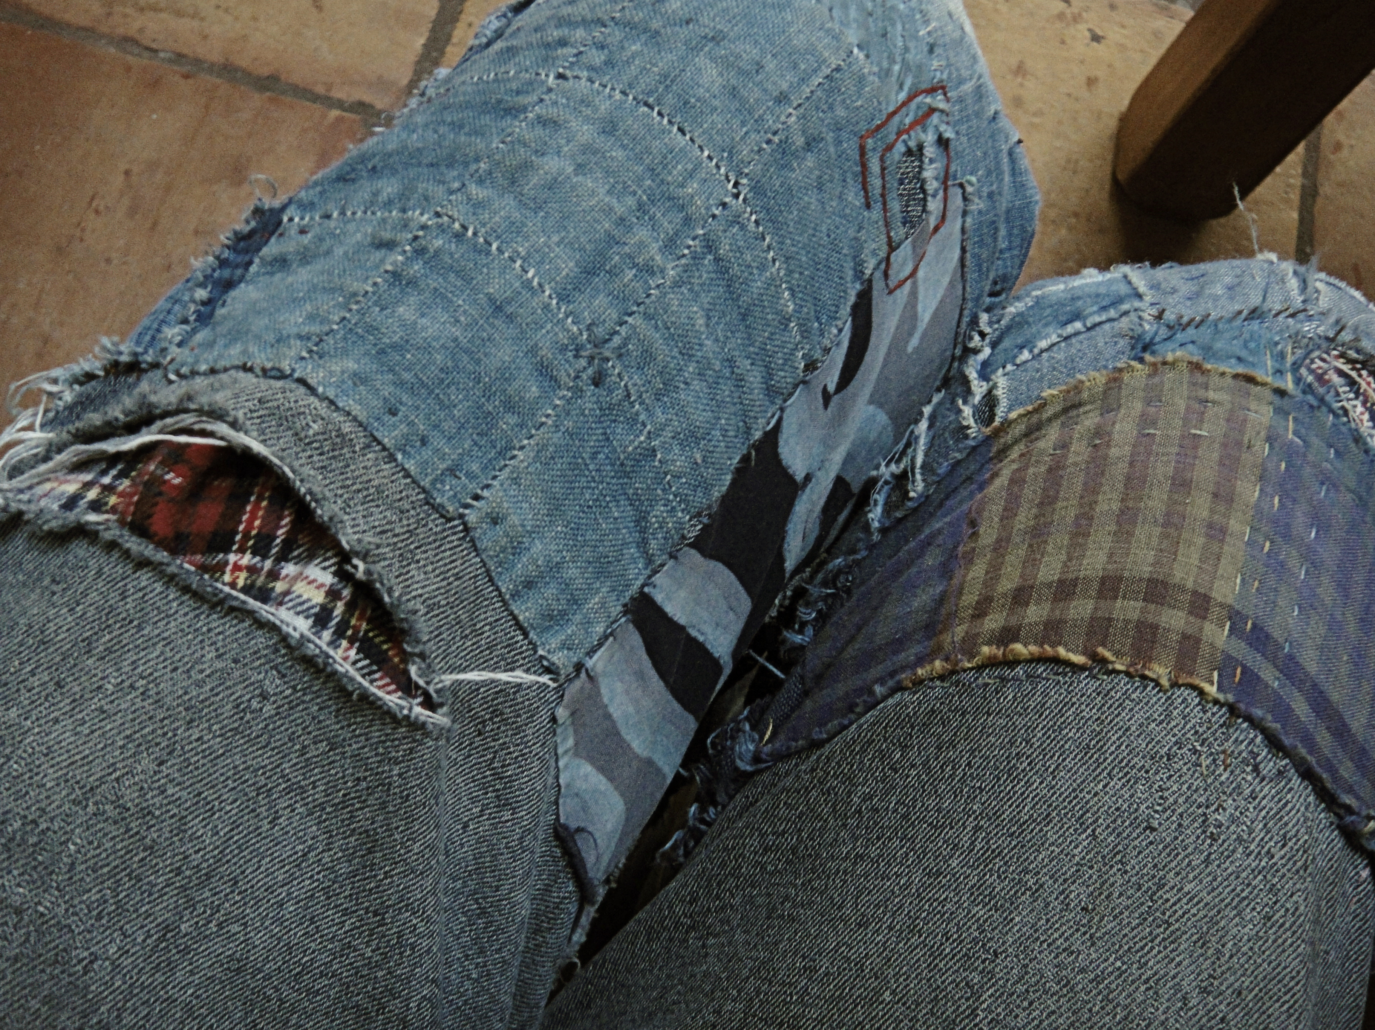
Patching
Notes:
The final area I’m going to cover is our automated patching. This is where everything went wrong in our CRS.

Slide 44
Automated Patching
We convert CBs to LLVM IR with McSema
We identify all taint input sources
Locate all tainted loads and stores
In loops only (as an optimization)
Added checks to verify they’re safe
Notes:
Our patcher converted binaries to the LLVM intermediate language with McSema. We identified any loads or stores that were influenced or tainted by input data and we added integrity checks to each of them.

Slide 45

How Replacement Binaries are made
Notes:
I put together a small animation to describe our we made our replacement binaries.

Slide 46

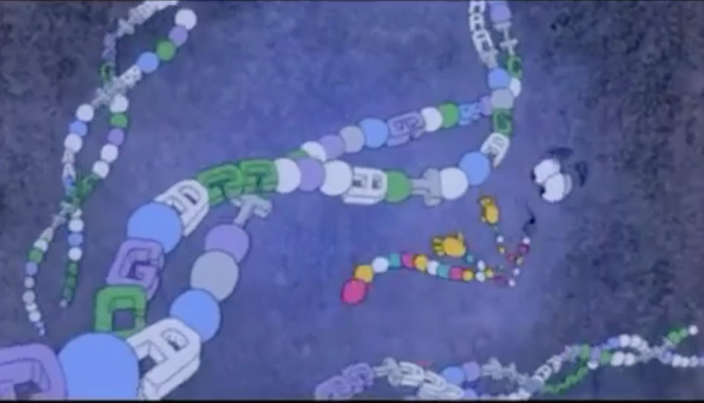


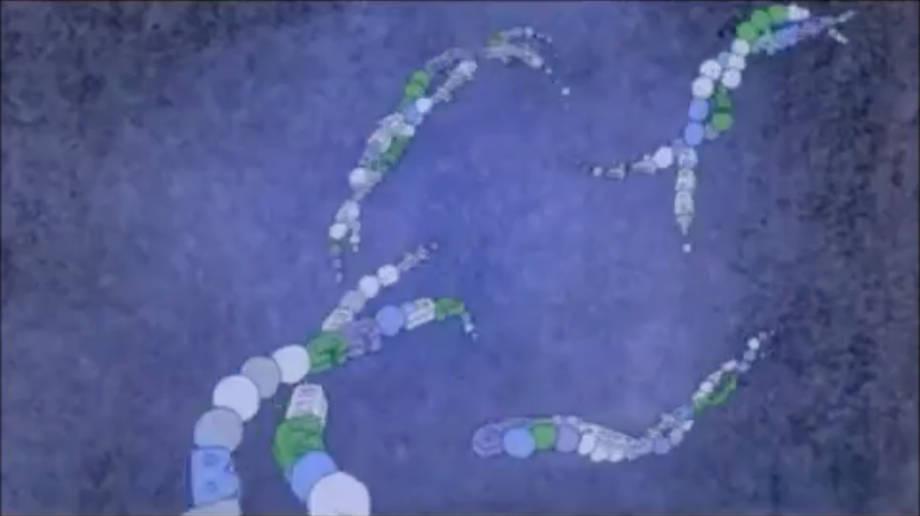
Challenge
Binary
Patch
McSema
Replacement
Binary
LLVM IR
Notes:
In recap, the frog is a challenge binary. Mcsema converts it to llvm IR. We inject our patches and then use the LLVM tool chain to emit a replacement binary.

Slide 47
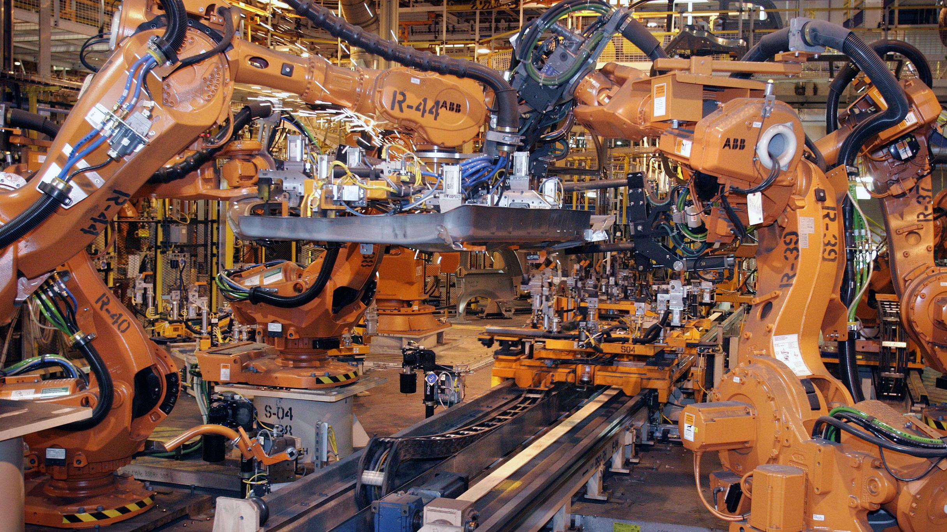
Demo
Notes:
I have a short-ish demo video showing the CRS in action. It’s not very exciting, but the video shows our CRS ingesting a challenge bundle of 12 challenges, automatically unpacking them, identifying vulnerabilities, developing exploits, and patching them.

Slide 48

Questions?

Slide 49
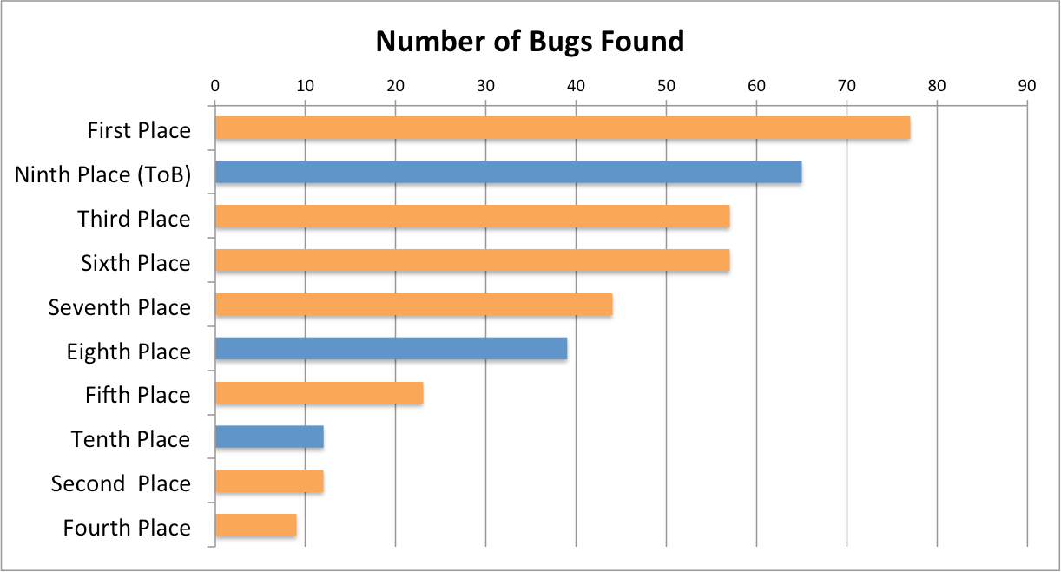

Slide 50
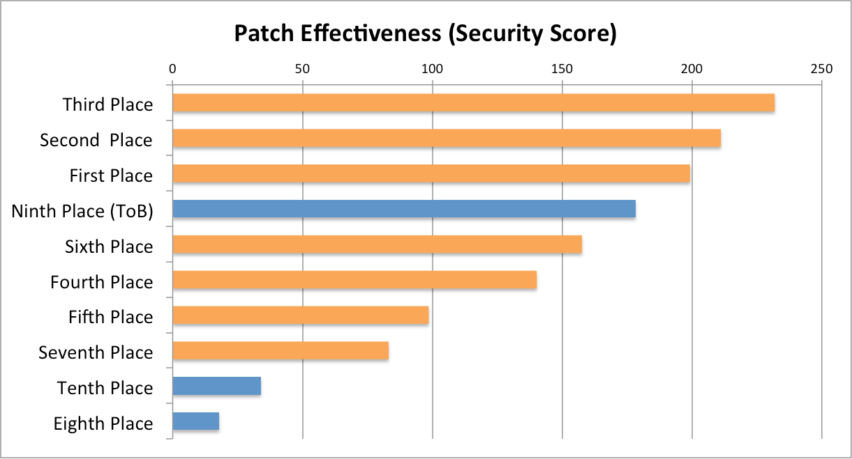

Slide 51
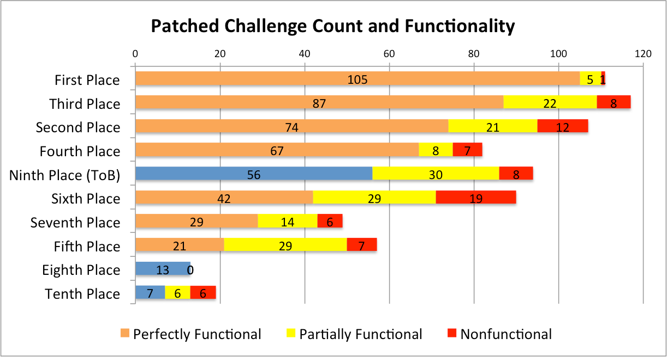

Slide 52
